Slide 1
Microservice Architecture & Azure
Kris Langford
Microsoft Technical Evangelist
Bob Familiar
Practice Director, Cloud & Services, BlueMetal, Inc.

Slide 2


Meet Kris Lankford | ‏@KrisLankford
Kris Lankford is a Senior Product Manager for Developer Tools at Microsoft. This job keeps him on the go and engaged with customers to ensure the product meets the need of the next generation of development and test in the cloud. Kris has more than fifteen years of experience in the software/IT Industry spanning engineering, leading agile teams, lean startups and product management. Through his experience Kris has introduced teams to lean product development and getting to the cloud. When he is not thinking about software - He likes to bike, ski, hike and do other outdoor activities with his family.

Slide 3


Meet Bob Familiar | @bobfamiliar
Practice Director, Cloud & Services for BlueMetal, Inc.
Solutions Architect focused on Azure, IoT and Microservices
Blogging at http://TheUndocumentedAPI.com
BlueMetal is an award winning Microsoft Gold Partner that specializes in Modern Applications
The Cloud & Services Team are practitioners of Lean Engineering, a high velocity product development process that applies Agile methodology, service oriented patterns and practices and cloud platform capabilities for the design and development of modern applications for the enterprise

Slide 4
Microservice Architectures in the Cloud
Module 1: Cloud, Continuous Delivery and Microservices
Module 2: Docker - Containers and Microservices
Module 3: Microservice Architecture for .NET
Module 4: Microservices and Internet of Things – Pharma Trial Demo

Slide 5
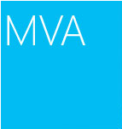
Join the MVA Community!
Microsoft Virtual Academy
Free online learning tailored for IT Pros and Developers
Over 3M registered users
Up-to-date, relevant training on variety of Microsoft products
“Earn while you learn!”
Get 50 MVA Points for this event!
Visit http://aka.ms/MVA-Voucher
Enter this code: ExploreMicroDocker (expires 6/8/2015)

Slide 6
Cloud, Continuous Delivery and Microservices
Module One

Slide 7
Agenda
Evolution of Software Architecture
What is a Microservice
Microservice Logical Architecture
Microservice Deployment Scenarios

Slide 8
Evolution of Software Architecture

Slide 9
Rethink Application Architecture
SaaS
Continuous Delivery
Cloud Platforms
Microservices

Slide 10
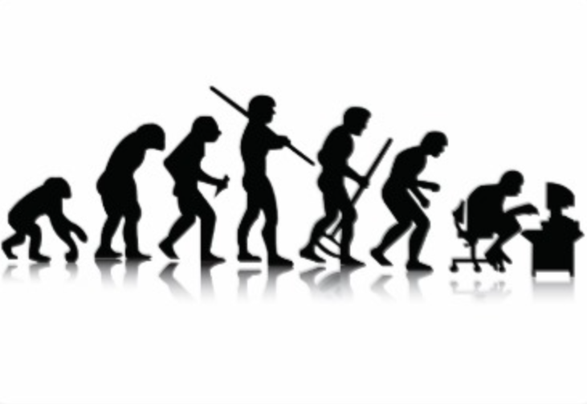
The Evolution of Architecture How did we get here?

Slide 11
Evolution
Methodology
Waterfall
Agile
Lean Engineering
Process
Gated
Scrum
Continuous Delivery
Patterns
2-Tier Monolithic
3-Tier Layered
Microservice Architecture
Platform
Windows
Windows / Linux
Cloud
Device
Desktop
Browser
Any Device

Slide 12
Evolution
Desktop
Client
Browser
Any Device
API Proxy
Web Server
Server
microservices
Db Server
From Monolithic to Microservice

Slide 13
What is a Microservice?

Slide 14
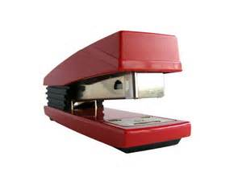
What is a Microservice?
Source: publicdomainpictures.net

Slide 15
Microservices are…
Autonomous
Isolated
Elastic
Resilient
Responsive
A microservice is a self-contained unit of functionality with loosely coupled dependencies on other services.
A microservice is a unit of deployment that can be modified, tested and deployed as a unit without impacting other areas of a solution
A microservice can be stateful or stateless and can be scaled independently of other services
A microservice is fault tolerant and highly available
A microservice responds to request in a reasonable amount of time

Slide 16
Microservices are… (cont.)
Configurable
Automated
Microservices rely on asynchronous message-passing to establish a boundary between components
Microservices provide API’s for access by developers and administrators and Applications are composed from multiple microservices
Microservices provide an API and/or a console that provides access to administrative operations
The lifecycle of a microservice is managed through automation that includes dev, build, test, staging, production and distribution
Message Oriented
Programmable
The intelligence in a system is found in the endpoints not on the wire. ESB is an anti-pattern to Microservices.
Intelligent

Slide 17
Benefits of a Microservices Approach
Evolutionary
Language agnostic APIs
Highly decoupled
Resilient
No monolith to fall over
Designed for failure
Speed of Development
Reusable and Composable
Open
Can be developed alongside existing monolithic applications providing a bridge to a future state
Reuse
Adding, updating and maintaining services and can be done at velocity

Slide 18
Benefits of a Microservices Approach (cont.)
Deployment Governance
On-demand scaling of smaller services leads to better cost control
Replaceable
Services can be rewritten and replaced with minimal downstream impact
Services are deployed independently
Scale Governance
Versioned
Owned
New API’s can be released without impacting clients that are using previous API’s
Microservices are typically owned by one team from development through deployment

Slide 19
Challenges with a Microservices Approach
Communication is Key
Speed of change requires investment in automation
Platform Matters
Your platform must support elastic scale and resilience. Look to the sky…it’s a bird…it’s a plane…it’s the cloud
Versioning must be Supported
Composability requires versioning
Domain Modeling
Rich domains can be more challenging to move to microservices
Automation is not an Option
Communication across teams becomes critical
Testing
Unit, inter-service, extra-service, composition testing
Discoverability
The ability to locate services in a distributed environment without being tightly coupled

Slide 20
Domain Modeling – Existing System
Bounded Context
How fast or slow areas of the system change can identify a seam
Team Structure
Service boundaries defined by how the org is structured
Pain
Whatever hurts most is a good candidate
Namespace Modeling
Partition by existing coupling
Rate of Change
Find the capability within the system - Where does the language change?

Slide 21
Domain Modeling – Green Field
User Stories
One service at a time
Single Responsibility
High Cohesion
Loose Coupling
Minimize dependencies
Evolutionary
Leverage User Journey to find the capabilities

Slide 22
Microservice Logical Architecture

Slide 23
Microservice Logical Architecture
Experience
Any client
SDK
SDK for accessing service
Protocol
Communication protocol such as REST/HTTP
Models
On the wire data models
Service
Business Rules/Logic
Store
Model persistent store
Automation
Continuous Delivery
DAC
Data Access
Any Client
Microservice
SDK
Protocol
Models
Automation
Protocol
Service
DAC
Store

Slide 24
Microservice Logical Architecture
UX
Any client / Administrators Console
SDK
Public/Private SDK
API
Public / Private API
Service
Rules, validations, calculations
Models
On the wire data models
Frameworks
Rest, DAC, Model Management
Store
Model persistent store
Automation
Continuous Delivery
Any Client
Admin Console
Microservice
Public SDK
Private SDK
Frameworks
Models
Automation
Public API
Private API
Public Service
Private Service
Frameworks
Store

Slide 25
Microservice Deployment Scenarios

Slide 26
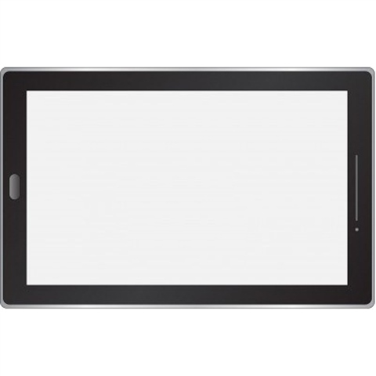
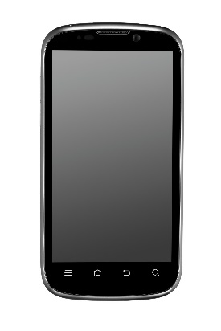
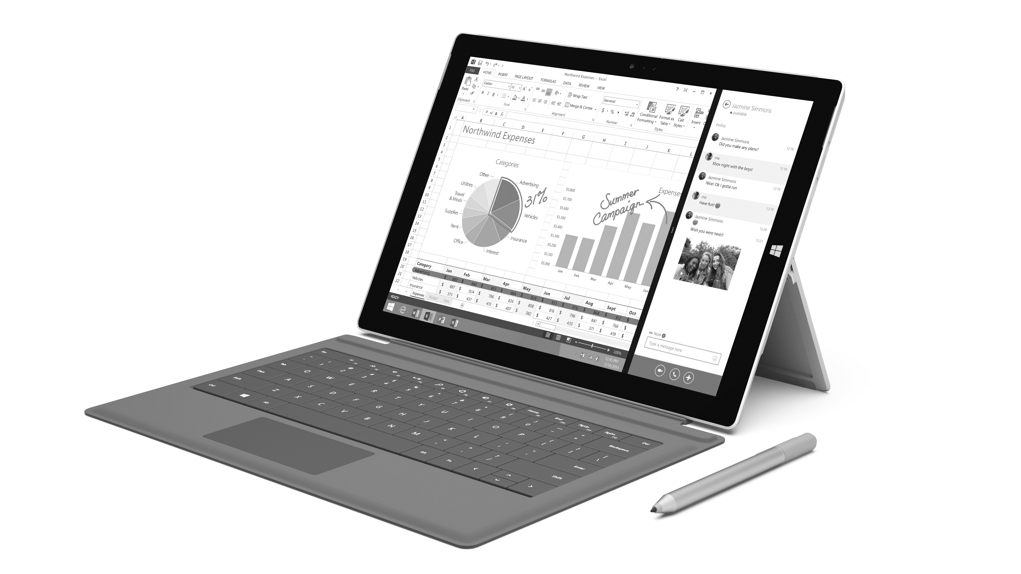
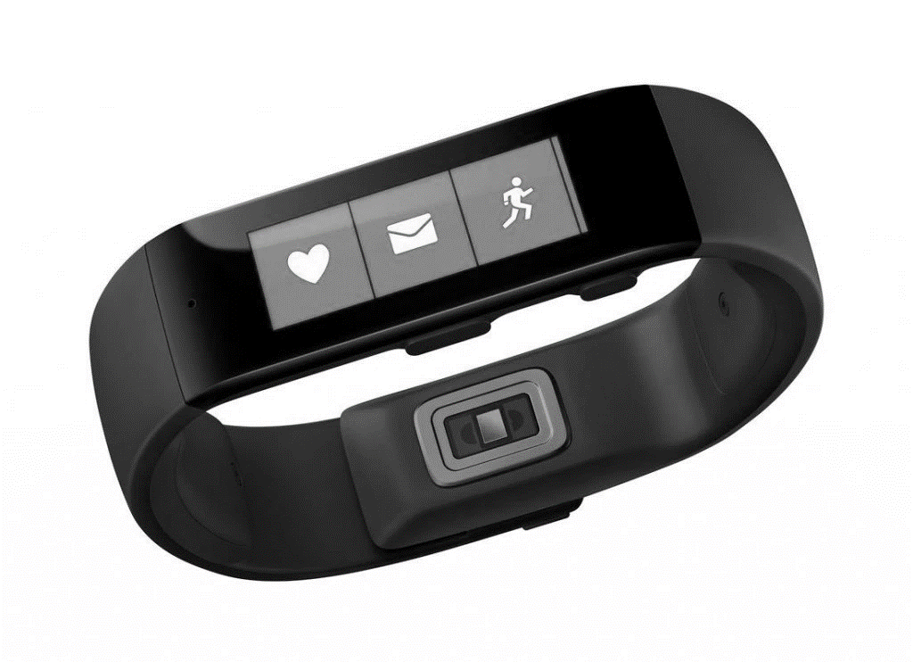

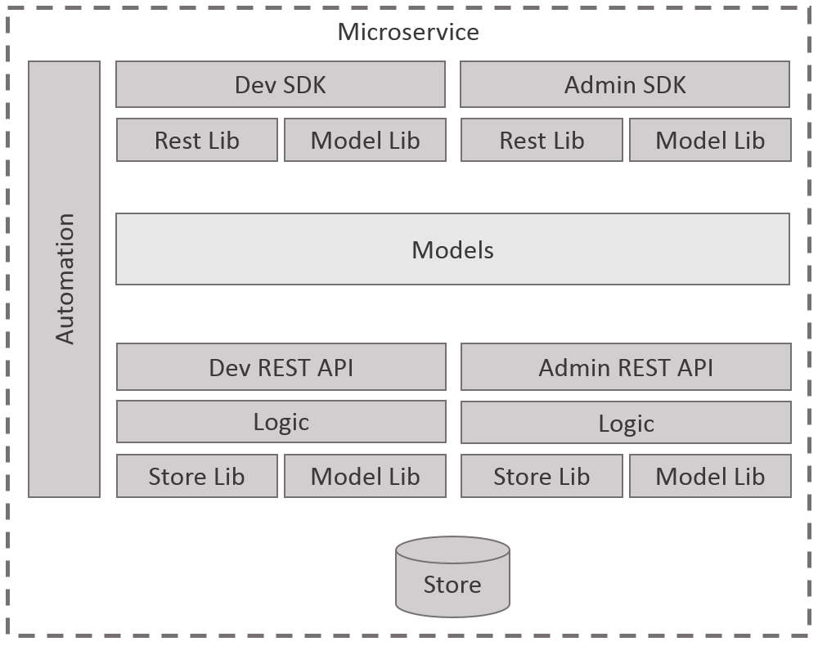
Any Client – Any Scale
Reference Data
Product Catalog
Workflow
Customer
Order

Slide 27
Deployment Governance VM’s
VM
VM
VM
Reference Data
Customer
Order

Slide 28
Deployment Governance Web Hosting Plans & Resource Groups (Azure)
Web Hosting Plan A
Web Hosting Plan B
Web Hosting Plan C
Resource Group A
Resource Group B
Resource Group C
Reference Data
Customer
Order

Slide 29
Deployment Governance Web Hosting Plans & Resource Groups (Azure)
Web Hosting Plan A
Web Hosting Plan B
Resource Group A
Resource Group B
Reference Data
Customer
Order

Slide 30

Deployment Governance Docker
VM
VM
Order Containers
Reference Data Container
Customer Container
Workflow Container

Slide 31
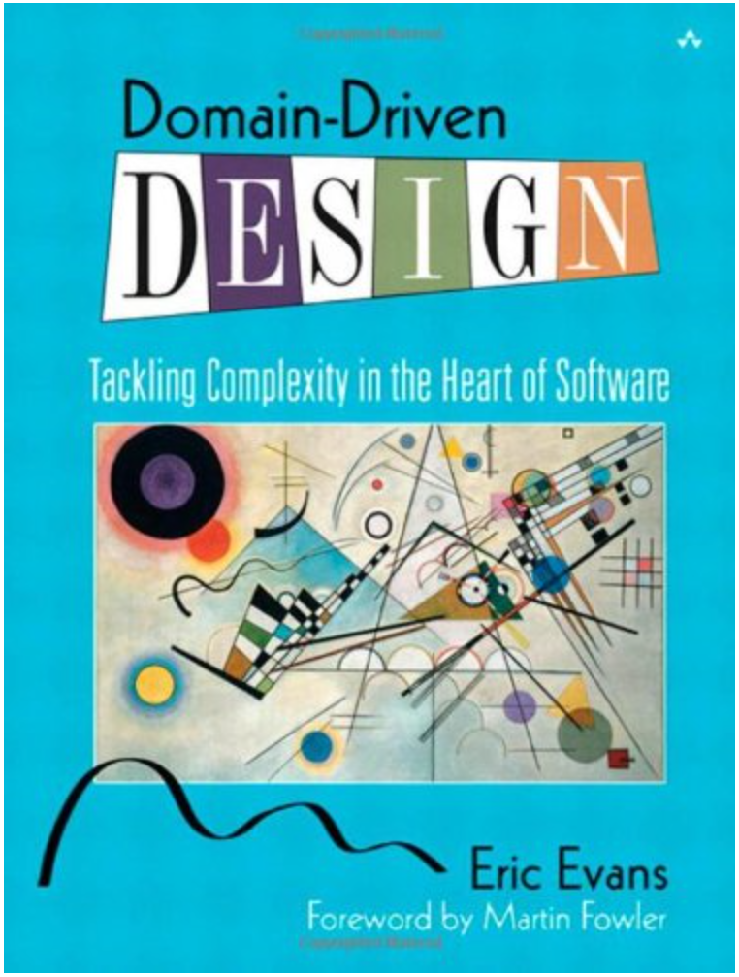
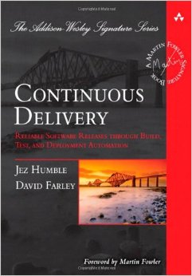
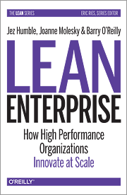
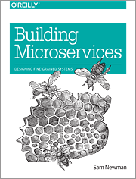
Reading
Domain Driven Design
Eric Evans
Continuous Delivery
Jez Humble
David Farley
Lean Enterprise
Jez Humble
Joanne Molesky
Barry O’Reilly
Building Microservices
Sam Newman

